Slide 1
Point estimator Confidence interval

Slide 2
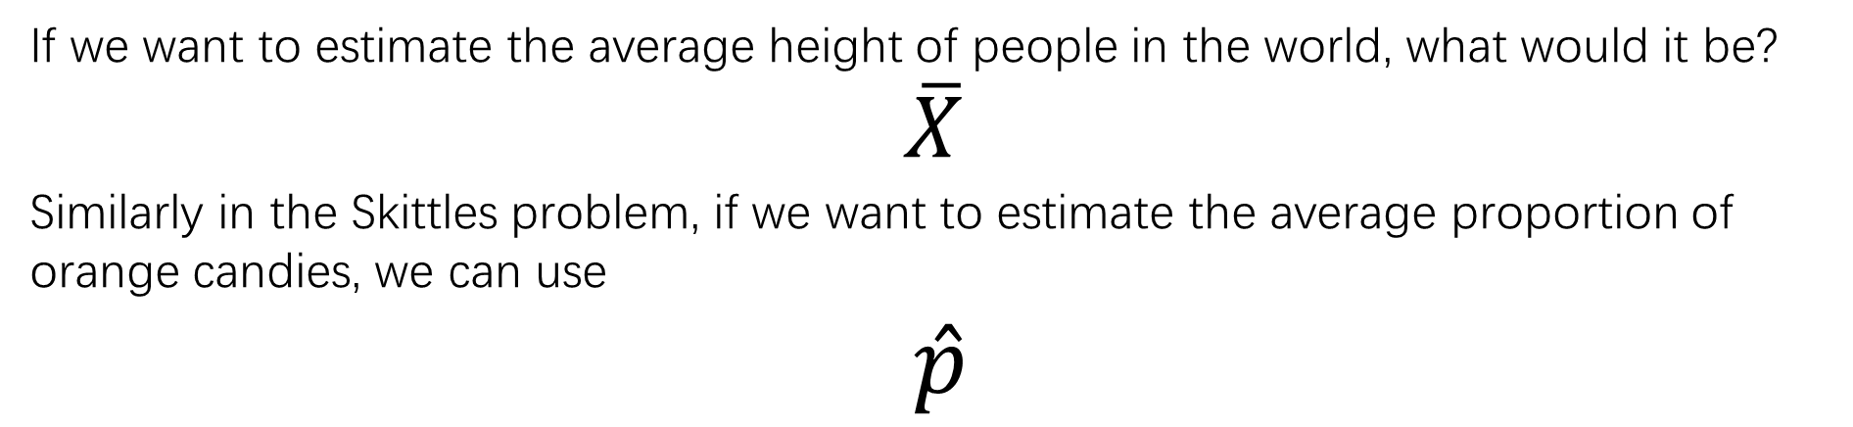
If we want to estimate the average height of people in the world, what would it be?
$$\overline{X}$$
Similarly in the Skittles problem, if we want to estimate the average proportion of orange candies, we can use
$\hat{p}$
They are point estimators
Definition:
A point estimator is a statistic that provides an estimate of a population parameter. Ideally, a point estimate is our “best guess” at the value of an unknown parameter.

Slide 3
If we want to estimate the average height of people in the world, what would it be?
$$\overline{X}$$
Similarly in the Skittles problem, if we want to estimate the average proportion of orange candies, we can use
$\hat{p}$
They are point estimators
Definition:
A point estimator is a statistic that provides an estimate of a population parameter. Ideally, a point estimate is our “best guess” at the value of an unknown parameter.
We learned that an ideal point estimator will have no bias and low variability.
Variability is always present when calculating statistics from different samples. Repeated sampling could yield different results.

Slide 4
One sample mean is 168cm
We want to know the average height of people in the world.
☹
☺Better
Use an interval centered at the sample mean.
P(the average height is between 148cm and 188cm) = ?
Confidence Interval !!!

Slide 5
Def. Confidence interval for a population characteristic is an interval of plausible values for the characteristic.
It is constructed so that, with a chosen degree of confidence, the actual value of the population characteristic will be between the lower and the upper endpoints of the interval.
FRQ:
We are C% confident that the interval from _____ to _____ captures the actual value of the [population parameter in context].
The degree of confidence = the confidence level
C% -> confidence level

Slide 7
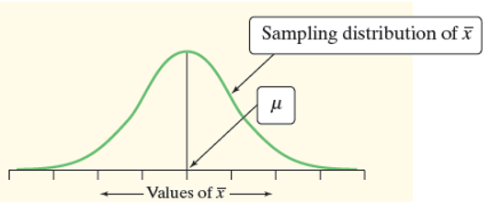
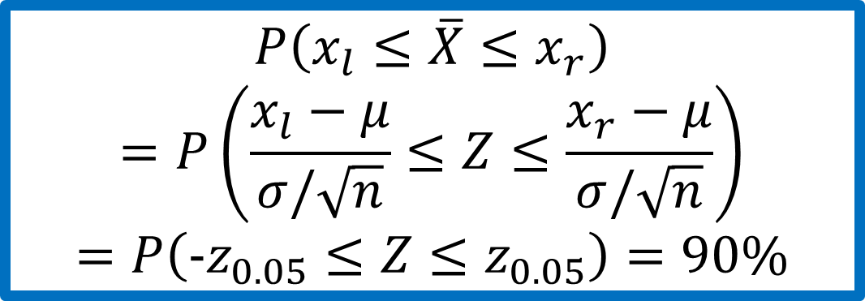
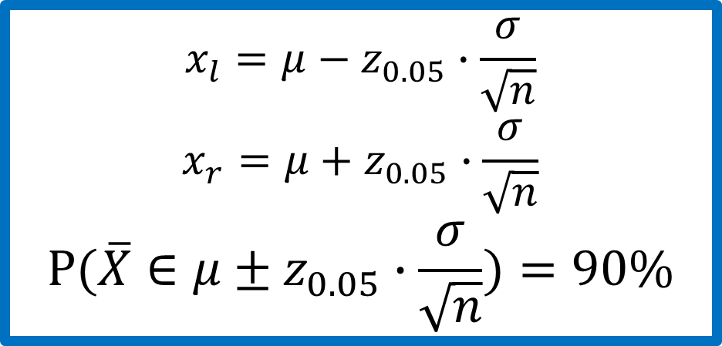

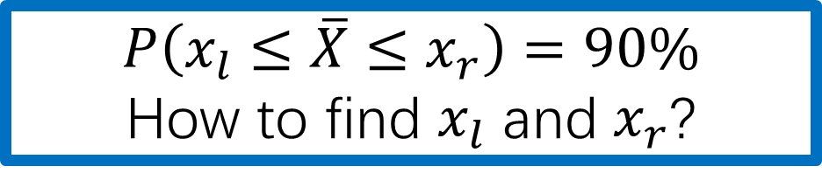
What is the 90% confidence interval?
$$P\left(x_{l}≤\overline{X}≤x_{r}\right)=90\%$$
How to find $x_{l}$ and $x_{r}$?
$$P\left(x_{l}≤\overline{X}≤x_{r}\right)$$
$$=P\left(\frac{x_{l}−μ}{σ/\sqrt{n}}≤Z≤\frac{x_{r}−μ}{σ/\sqrt{n}}\right)$$
$$=P\left({-z}_{0.05}≤Z≤z_{0.05}\right)=90\%$$
$$x_{l}=μ−z_{0.05}∙\frac{σ}{\sqrt{n}}$$
$$x_{r}=μ+z_{0.05}∙\frac{σ}{\sqrt{n}}$$
$$P(\overline{X}∈μ±z_{0.05}∙\frac{σ}{\sqrt{n}})=90\%$$
$$P\left(Z≥z_{0.05}\right)=0.05$$

Slide 8
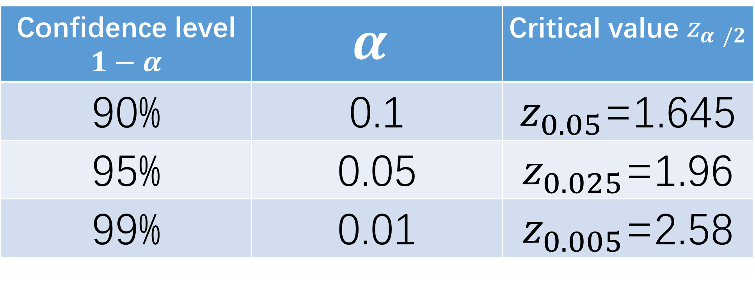
Confidence level $1−α$ | $$α$$ | Critical value $z_{α /2}$
90% | 0.1 | $z_{0.05}$=1.645
95% | 0.05 | $z_{0.025}$=1.96
99% | 0.01 | $z_{0.005}$=2.58

Slide 9


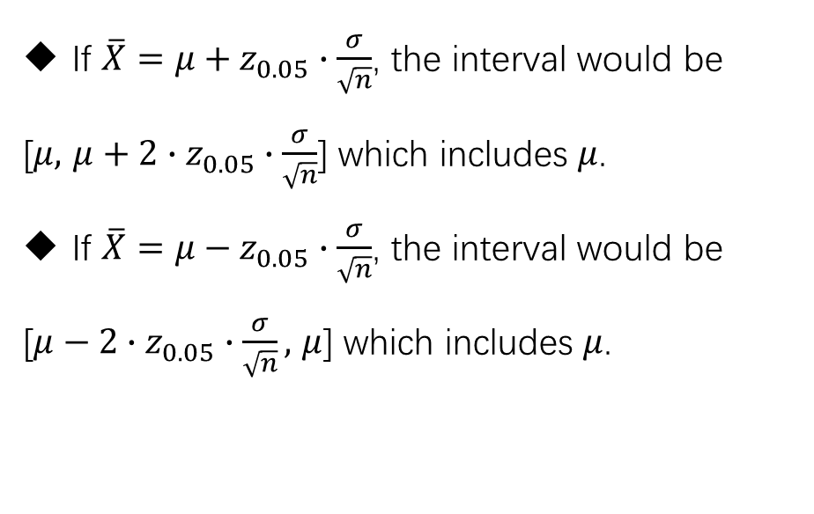
90% of sample means will fall into the interval
[$μ−z_{0.05}∙\frac{σ}{\sqrt{n}},$ $μ+z_{0.05}∙\frac{σ}{\sqrt{n}}$]
If $\overline{X}=μ+z_{0.05}∙\frac{σ}{\sqrt{n}}$, the interval would be
[$μ,$ $μ+2∙z_{0.05}∙\frac{σ}{\sqrt{n}}$] which includes $μ$.
If $\overline{X}=μ−z_{0.05}∙\frac{σ}{\sqrt{n}}$, the interval would be
[$μ−2∙z_{0.05}∙\frac{σ}{\sqrt{n}},$ $μ$] which includes $μ$.
90% of intervals [$\overline{X}−z_{0.05}∙\frac{σ}{\sqrt{n}}$, $\overline{X}+z_{0.05}∙\frac{σ}{\sqrt{n}}$]
will include the true mean.

Slide 10

90% of sample means will fall into the interval
[$μ−z_{0.05}∙\frac{σ}{\sqrt{n}},$ $μ+z_{0.05}∙\frac{σ}{\sqrt{n}}$]
If $\overline{X}=μ+z_{0.05}∙\frac{σ}{\sqrt{n}}$, the interval would be
[$μ,$ $μ+2∙z_{0.05}∙\frac{σ}{\sqrt{n}}$] which includes $μ$.
If $\overline{X}=μ−z_{0.05}∙\frac{σ}{\sqrt{n}}$, the interval would be
[$μ−2∙z_{0.05}∙\frac{σ}{\sqrt{n}},$ $μ$] which includes $μ$.
90% of intervals [$\overline{X}−z_{0.05}∙\frac{σ}{\sqrt{n}}$, $\overline{X}+z_{0.05}∙\frac{σ}{\sqrt{n}}$]
will include the true mean-> is a constant, not random.

Slide 11
Confidence Levels and Confidence Intervals
The confidence level tells us how likely it is that the method we are using will produce an interval that captures the population parameter if we use it many times. The confidence level does not tell us the chance that a particular confidence interval captures the population parameter

Slide 12
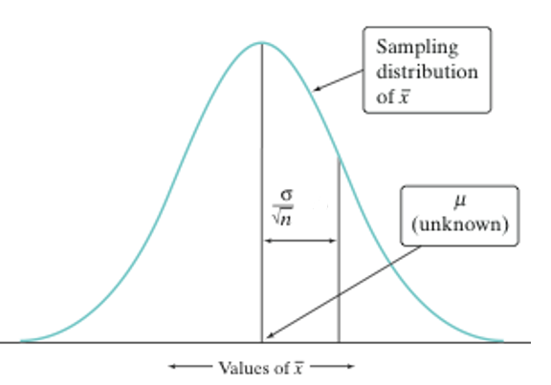
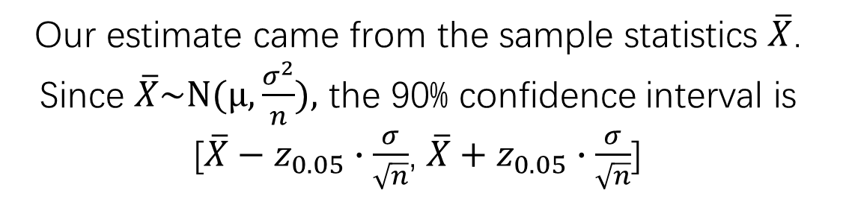

Constructing a C.I.
Our estimate came from the sample statistics $\overline{X}$. Since $\overline{X}\sim N(μ,\frac{σ^{2}}{n}),$ the 90% confidence interval is [$\overline{X}−z_{0.05}∙\frac{σ}{\sqrt{n}}$, $\overline{X}+z_{0.05}∙\frac{σ}{\sqrt{n}}$]
Critical value: $z_{0.05}$
Margin of error (ME): $z_{0.05}∙\frac{σ}{\sqrt{n}}$
This leads to a more general formula for confidence intervals:
statistic ± (critical value) • (standard deviation of statistic)

Slide 13
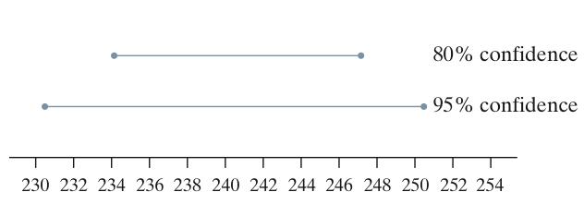
Properties of Confidence Intervals:
The user chooses the confidence level, and the margin of error follows from this choice.
The critical value depends on the confidence level and the sampling distribution of the statistic.
Greater confidence requires a larger critical value
The standard deviation of the statistic depends on the sample size n
The margin of error gets smaller when:
The confidence level decreases
The sample size n increases

Slide 14
Using Confidence Intervals
Before calculating a confidence interval for µ or p there are three important conditions that you should check.
1) Random: The data should come from a well-designed random sample or randomized experiment.
2) Normal: The sampling distribution of the statistic is approximately Normal.
For means: The sampling distribution is exactly Normal if the population distribution is Normal. When the population distribution is not Normal, then the central limit theorem tells us the sampling distribution will be approximately Normal if n is sufficiently large (n ≥ 30).
For proportions: We can use the Normal approximation to the sampling distribution as long as np ≥ 10 and n(1 – p) ≥ 10.
3) Independent & 10% condition: Individual observations are independent. When sampling without replacement, the sample size n should be no more than 10% of the population size N (the 10% condition) to use our formula for the standard deviation of the statistic.

Slide 15
http://digitalfirst.bfwpub.com/stats_applet/stats_applet_4_ci.html

